Slide 1

Light Chemistry PreAP/GT

Slide 2
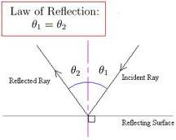
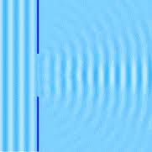
Particle wave duality
Isaac Newton believed that light acted as both a particle and as a wave depending on the type of interaction.
Reflection- it was a particle
bouncing off a barrier
Diffraction- it was a wave
bending around a barrier

Slide 3
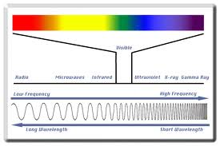
Electromagnetic Spectrum

Slide 4

Speed of Light
Cosmic speed limit- nothing can travel faster than the speed of light
E=mc2
C= the speed of light 3.00 x 108 m/s
The faster you go the more energy that is required and the more massive you become.

Slide 5
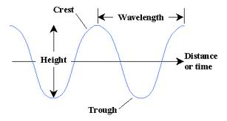
Parts of a wave

Slide 6
Parts continued
Wavelength- the distance from crest to crest or trough to trough on a wave given the symbol (λ)
Amplitude- the strength of the wave in light this would be related to brightness
Frequency (ν) the number of waves that pass a point in a given time period.
Energy (E)- is directly related to the waves frequency. The shorter the wavelength the greater the frequency- the greater the energy.
E= ħν

Slide 7
More equations to know
c=λ ν
E=ħ ν
Ħ= plancks constant=6.62620x 10-34 Js

Slide 8
Atomic Emission spectrum
Every element emits light when it excited by heat or electricity. An electron will absorb energy and move to a higher orbital position, then the atom emits energy in the form of light when the electron moves back to a lower orbital position.

Slide 9
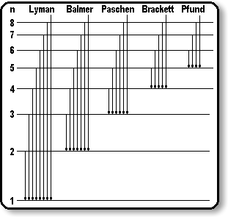

Slide 10
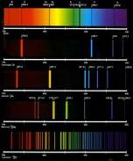
Line Spectrum

Slide 11
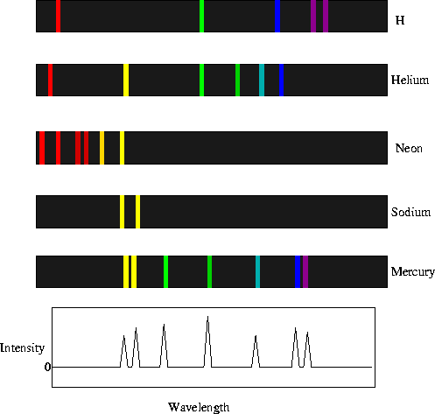

Slide 12
View This
http://player.discoveryeducation.com/index.cfm?guidAssetId=EDD07B0A-1C1D-424F-9E68-6ABDF28CEBB4
http://player.discoveryeducation.com/index.cfm?guidAssetId=F5BB99DA-6D33-40D1-B8EF-21B4CF0A570F

Slide 13
The end

